Slide 1

CHINOOK MUSIC STORE ANALYSIS
SUMANTH RAJ S
7-5-25

Slide 2
AGENDA
ABOUT CHINOOK
OBJECTIVE
DATABASE SCHEMA
RECOMMENDATIONS
CONCLUSION

Slide 3

ABOUT CHINOOK
Chinook Music Store is a renowned platform that offers a diverse collection of music records in physical formats, catering to a global audience of music enthusiasts. With a rich catalog spanning various genres and artists, Chinook has established itself as a trusted destination for quality music. As the music industry evolves, understanding customer preferences and market dynamics has become increasingly vital for maintaining a competitive edge and driving business growth.

Slide 4

OBJECTIVE
The primary objective of this analysis is to examine Chinook's sales data to uncover actionable insights that can inform strategic decisions. By analyzing customer demographics, purchasing patterns, and sales performance across genres and geographies, the aim is to identify key trends and opportunities. These insights will be used to recommend strategies that enhance customer engagement, optimize inventory management, and boost revenue in the physical music market.

Slide 5
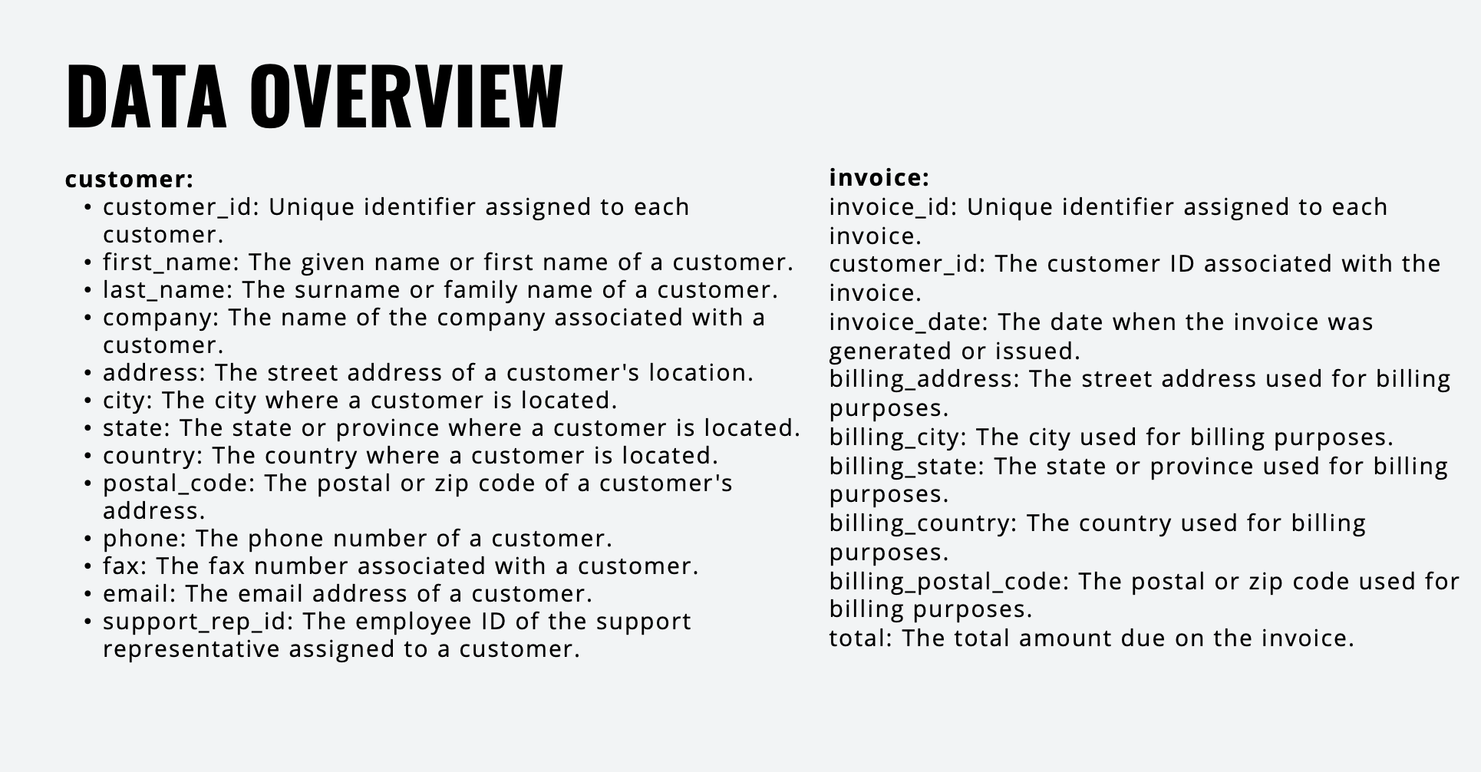

Slide 6
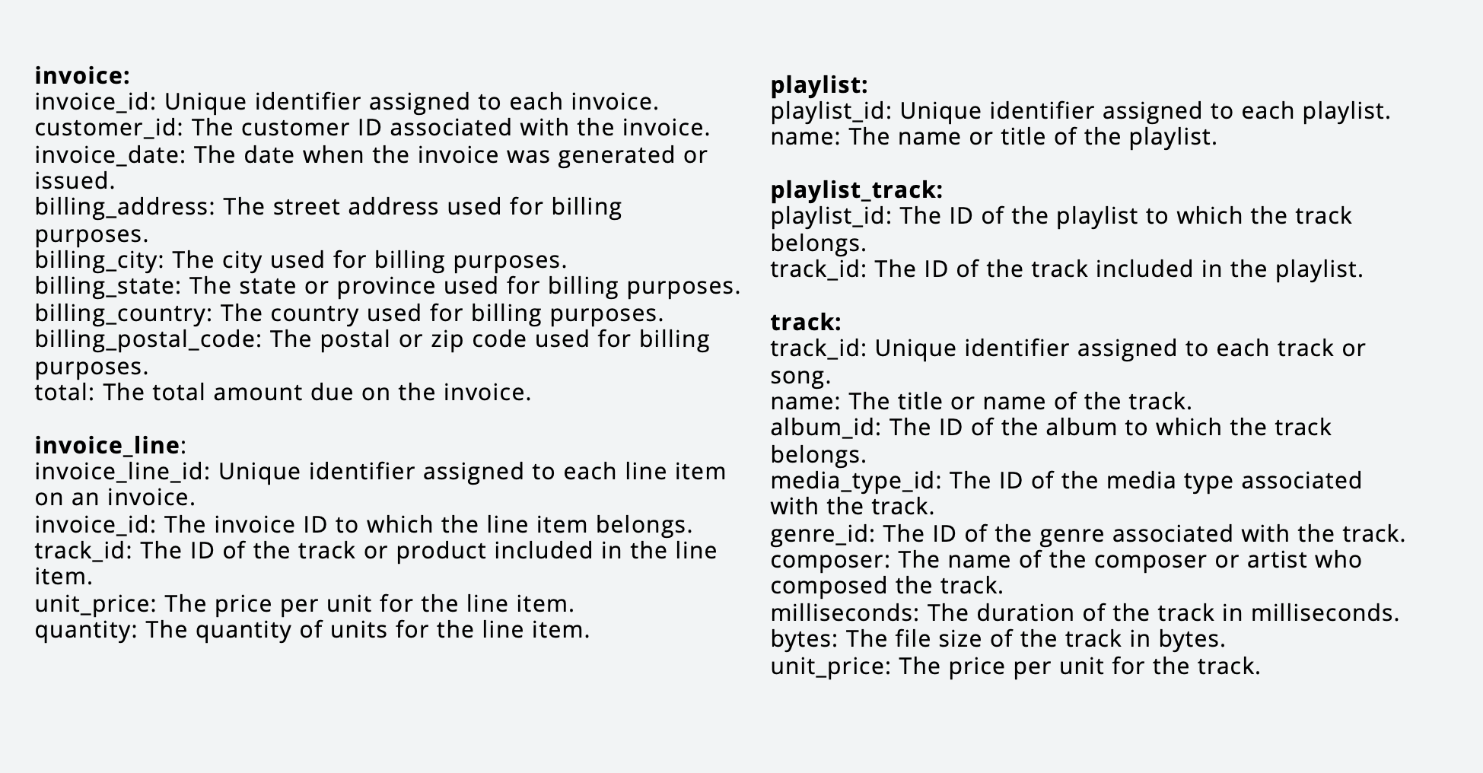

Slide 7
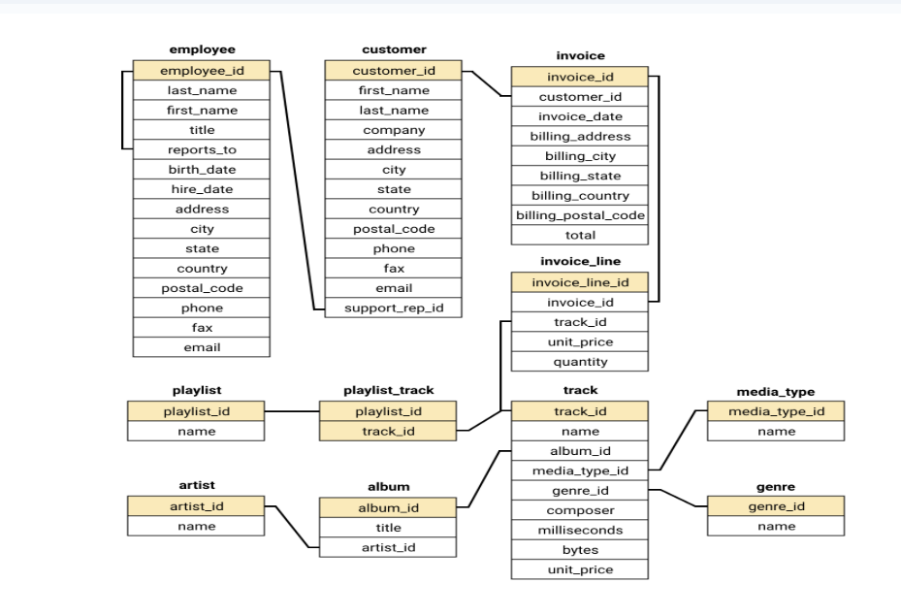
DATABASE SCHEMA

Slide 8
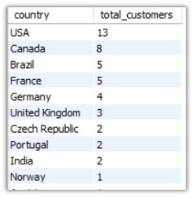
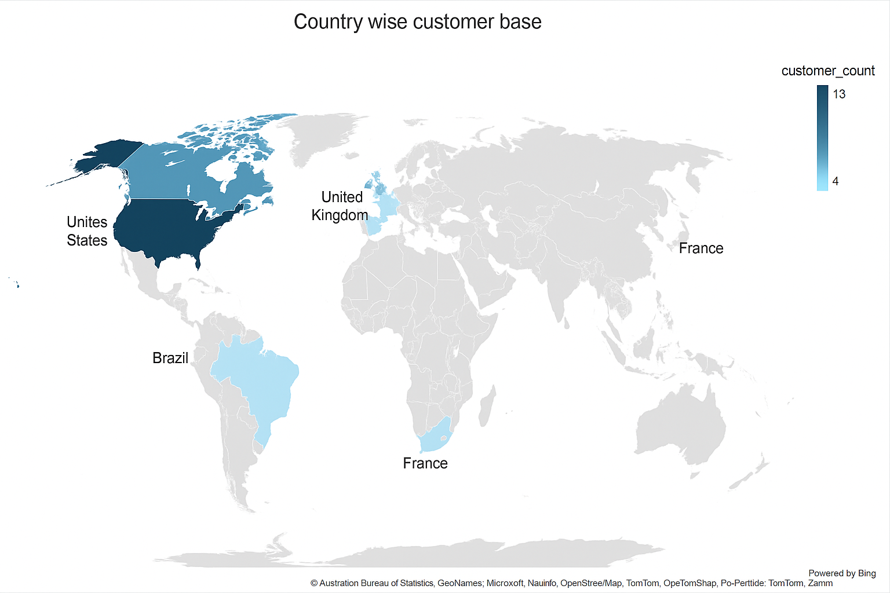
Customer’s Demographic Breakdown
Insights :
USA , CANADA , Brazil , France shows largest customer base. Norway , Italy , Spain are among the least customer base

Slide 9
Total Revenue and Invoices by Country

Slide 10
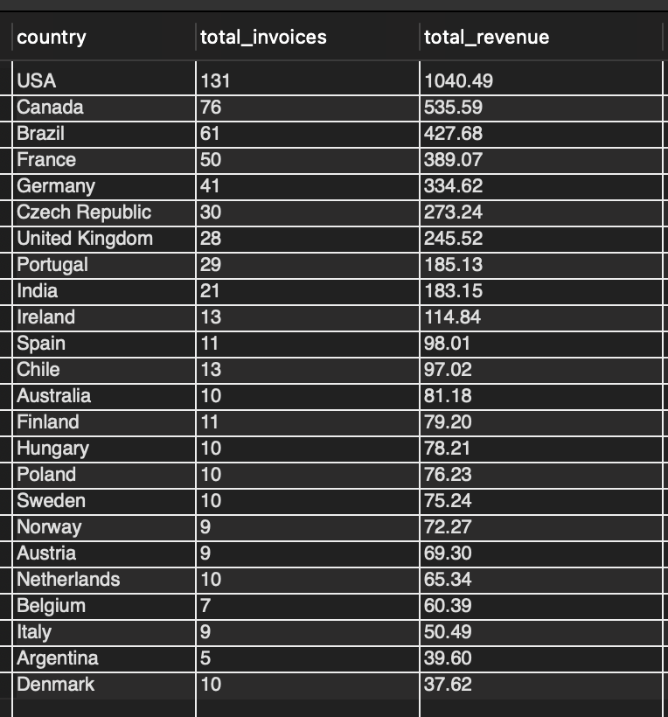
Insights : USA ,CANADA , BRAZIL
are the top 3 countries with high sales and number of purchases

Slide 11
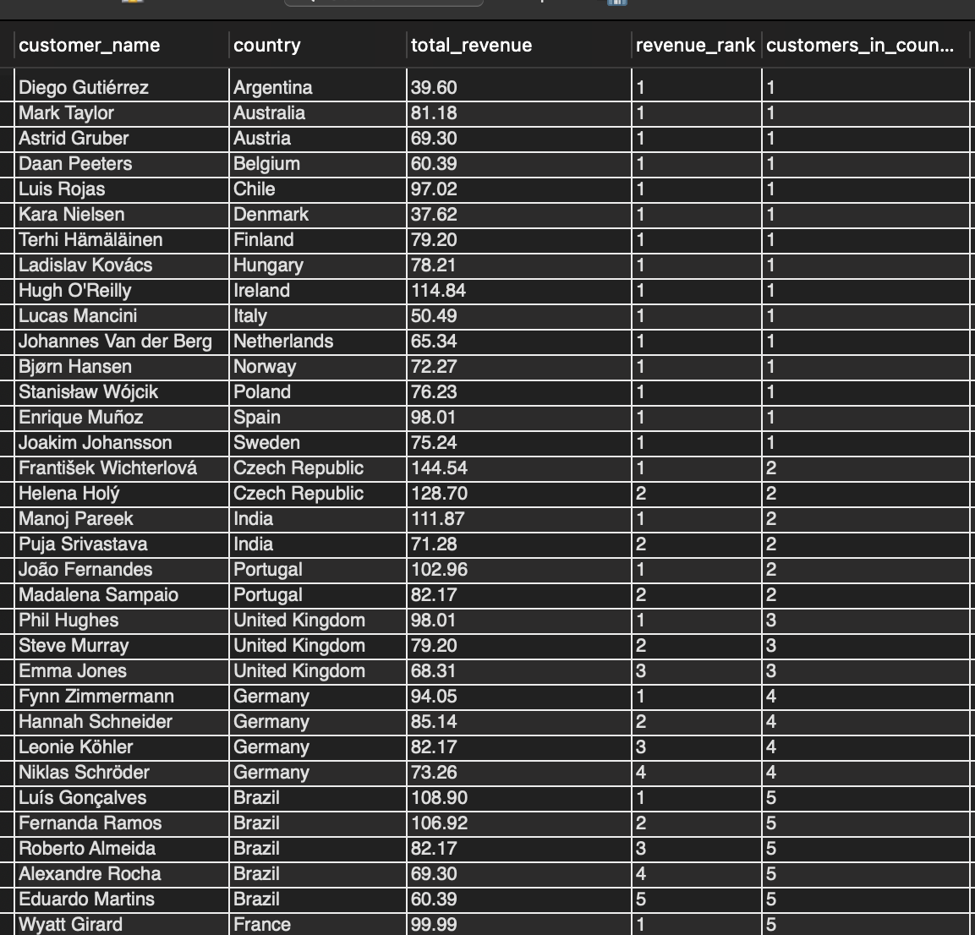
TOP 5 CUSTOMERS BY TOTAL REVENUE IN EACH COUNTRY
-'Diego Gutiérrez'– ranks 1st in Argentina and he is the only customer from Argentina
-Francois Tremblay ‘ranks 1st in Canada among the top 5 customers
Customers are spread across various countries, with notable contributions from Brazil, the USA, Canada, and the Czech Republic.

Slide 12
Genre Sales Analysis

Slide 13
Insights :
While Rock leads by a wide margin, there is notable diversity in preferences for other genres such as Metal, Alternative & Punk, and Latin, which show moderate levels of interest. Genres like Pop and Easy Listening however, have relatively low engagement, suggesting limited appeal.

Slide 14
Customers who have purchased track from 3 different genre
Insights :
Leonie Köhler is the customer with the highest genre diversity, having purchased tracks across 14 different genres.
Several customers, including František Wichterlová, Terhi Hämäläinen, Madalena Sampaio, and others, have purchased from 13 different genres, indicating a broad music taste.

Slide 15
Long term and Short term(new) Customers

Slide 16
INSIGHTS
Insights on Customer Loyalty and Retention
Long-term customers spend more: Long-term customers have a significantly higher total spend and basket size. This indicates strong customer lifetime value and shows that these customers are more engaged and profitable.
Higher purchase frequency: Long-term customers purchase more often, which suggests they are consistent buyers. This indicates a level of trust or preference for the brand or platform.
Larger basket sizes: They tend to buy more items per transaction. This may imply they are more confident in their purchasing decisions or are shopping for broader needs.
Slightly higher average order value: While the difference in order value is not very large, the total contribution from long-term customers is significantly higher due to increased purchase frequency and basket size.

Slide 17
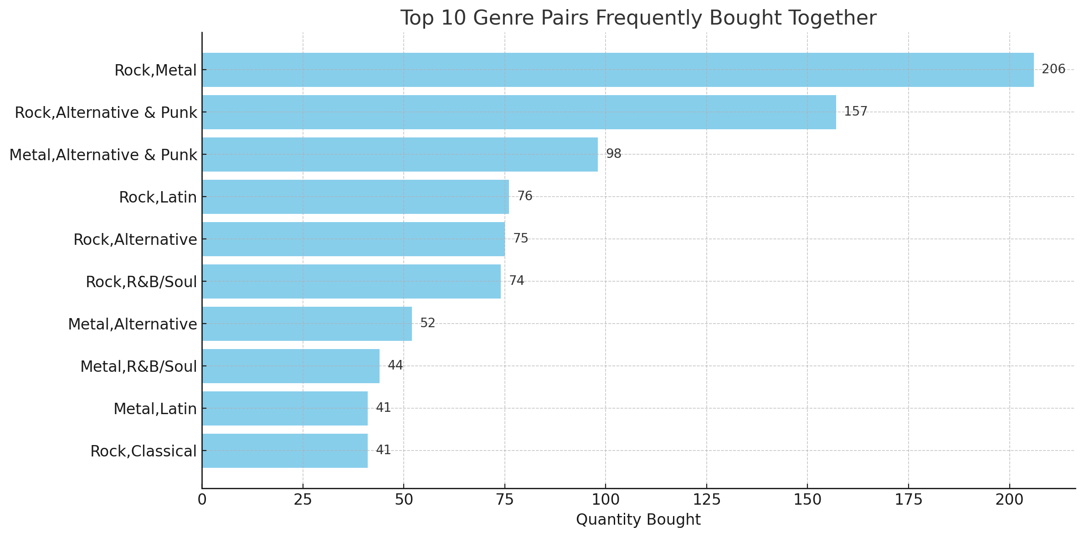
GENRE, ALBUM , ARTIST AFFINITY

Slide 20
INSIGHTS
Artist affinity :
Eric Clapton & Nirvana and Queen & U2 have the highest combined purchase count of 16, making them the most popular artist pairs.
Green Day & Guns N’ Roses and Nirvana & The Rolling Stones follow closely with a count of 15, showing strong fan overlap.
Artists like Green Day, Nirvana, Aerosmith, Foo Fighters, and Led Zeppelin consistently appear in high-affinity combinations.
These artists can be bundled in combo offers or artist packs to increase sales across fan bases.
Introducing lucky draws, exclusive merchandise, or bundle discounts for these combos can further drive purchases and attract more buyers.
Genre affinity :
Rock-Metal (206) and Rock–Alternative & Punk (157) are the top-performing genre pairs, showing strong overlap in audience interest.
Keeping Rock and Metal at the center and pairing them with genres like Alternative & Punk, Latin, and Classical can help drive more sales.
Use personalized suggestions like "Customers who also bought this..." to guide users toward related genres.
Promote multi-genre playlists and host concerts featuring paired genres to attract a wider audience and boost sales.
Album affinity :
Mezmerize and Are you experienced are the most purchased together album combo.
Pairs like The singles, My generation and Dark side of the moon, the singles are also the popular combos
My generation, The Doors, Memorize, Big ones are central album by combining them with other albums like a combo playlist can bring more sales.

Slide 21
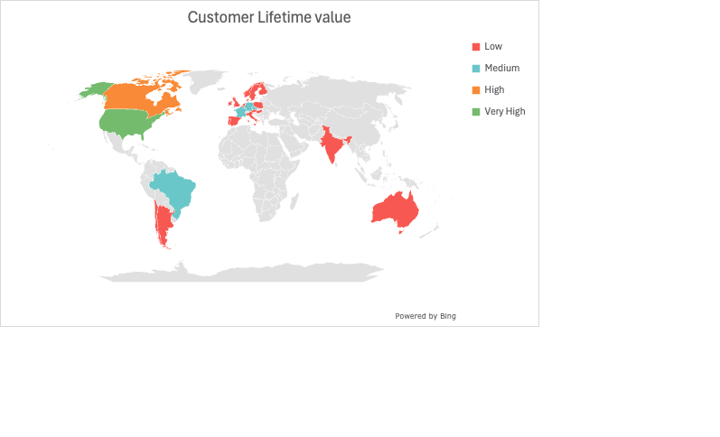
CUSTOMER LIFETIME VALUE

Slide 22
INSIGHTS
Range Label | LTV Range (approx.)
Low | 0 – 250
Medium | 251 – 500
High | 501 – 750
Very High | 751 – 1050
#USA tops in terms of high customer lifetime value
#Belgium turns out to be the only country with 100% churn rate
#Medium and High LTV should be the key focus countries

Slide 23
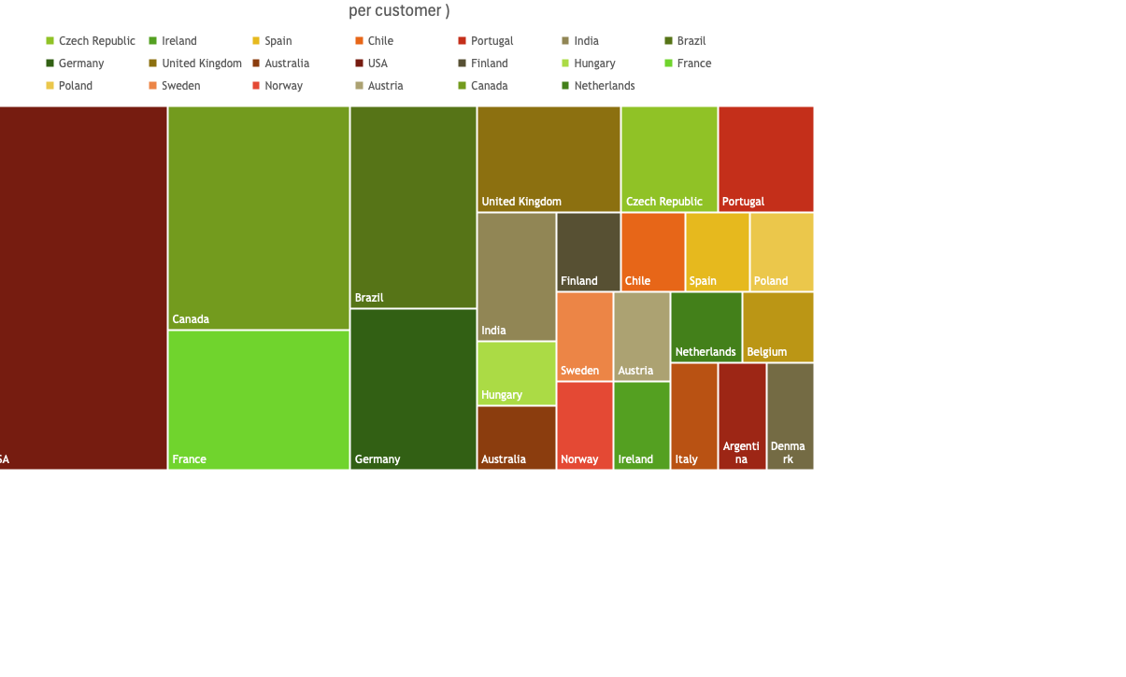

Slide 24

CONCLUSION
Data Integrity and Accuracy: Steps to address null values and duplicate entries have ensured the accuracy and reliability of the Chinook database for meaningful analysis.
Genre Popularity: Rock emerges as the dominant genre, especially in the USA, contributing significantly to sales. Strategic investment in Rock music can drive customer engagement and revenue growth. Regions like Brazil show unique preferences for genres such as Alternative & Punk and Metal, indicating the need for regionalized marketing strategies.
Customer Insights: Long-term customers demonstrate higher spending and loyalty, offering opportunities for premium services and exclusive promotions. Meanwhile, new customers represent growth potential through personalized marketing efforts.

Slide 25
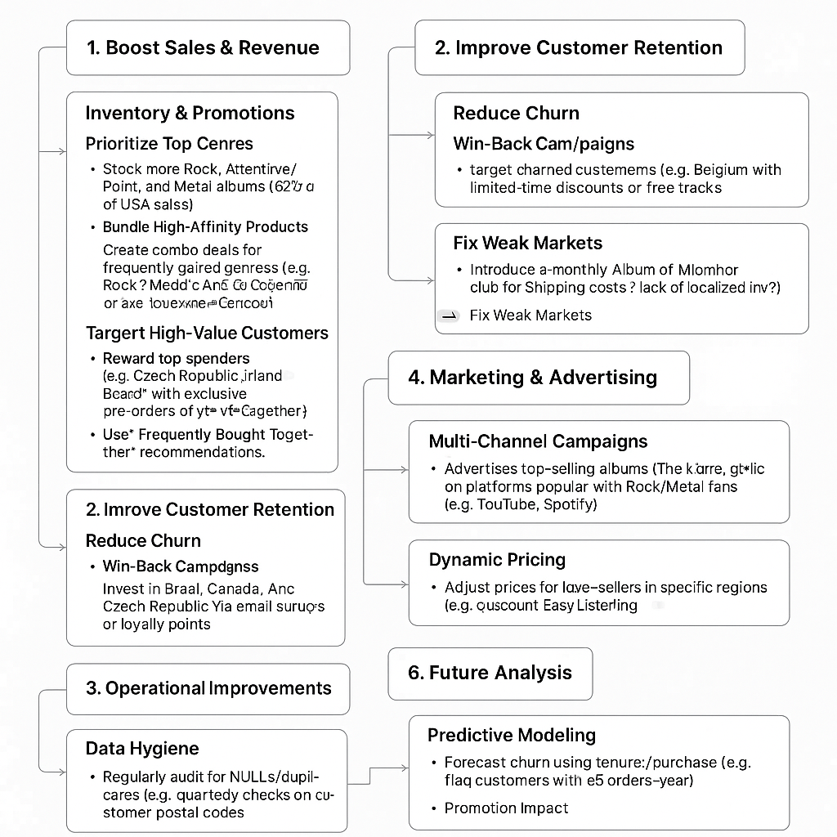
RECOMMENDATIONS

Slide 26
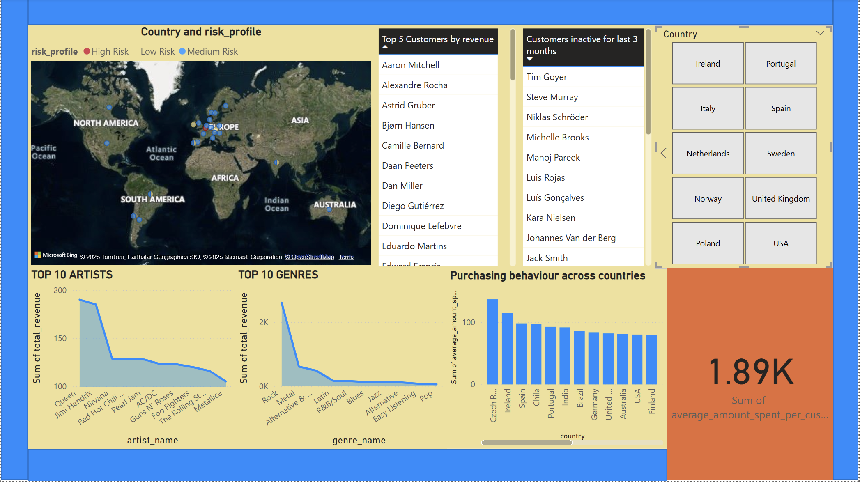
POWER BI DASHBOARD

Slide 27
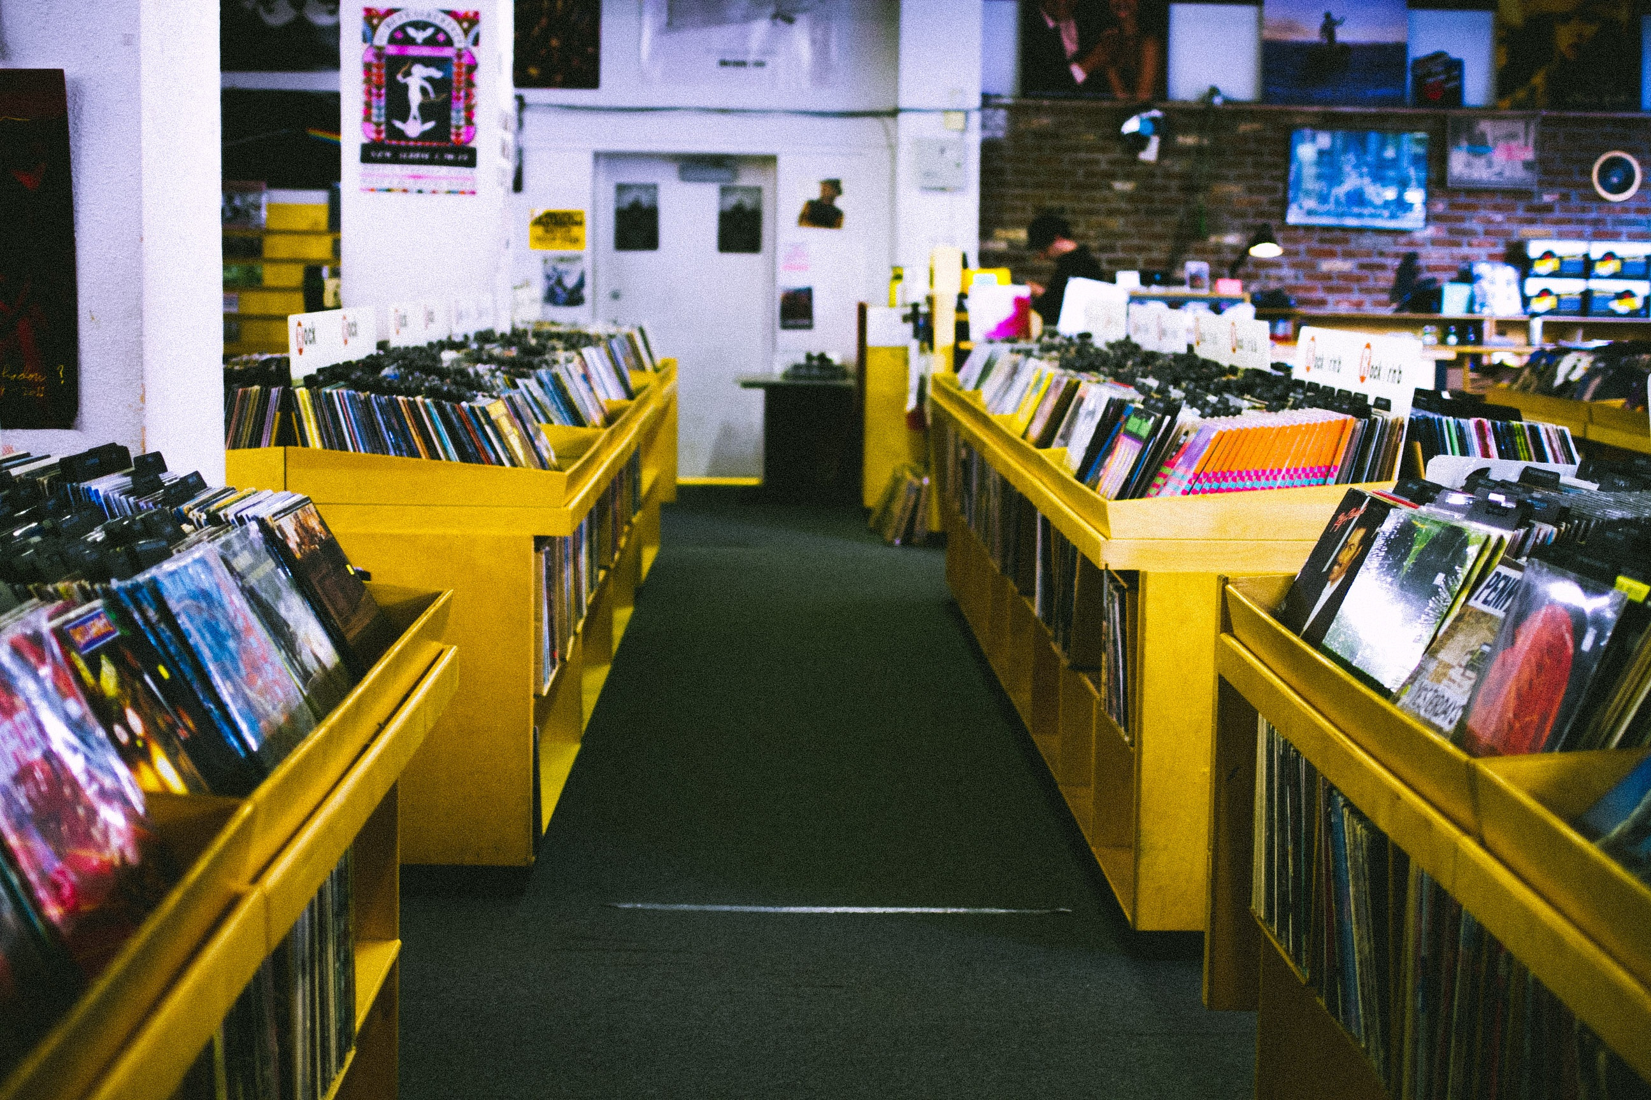
Description of DASHBOARD
This interactive dashboard provides a comprehensive overview of music sales and customer behaviour across countries. Key insights include:
Top 10 Artists and Genres by total revenue
Customer segmentation: Top revenue-generating customers and those inactive for 3+ months
Geographic distribution of risk profiles with map visualization
Country-wise purchasing behaviour using bar charts
An interactive slicer to filter insights by selected countries
Key KPI card showing average amount spent per customer

